Slide 1
Little Racers
Pitch Date: June 22 , 2019 Week 3: 7/13/2019
Release Date: September 15, 2019 9 weeks to go!
Team Lead: Vince McKeown
14 contributors (+1)

Slide 2
Updates to Code
Mike LeSauvage
Refactored Wall Collision Code
Corrections to other tiles (grass, cones)
Vince McKeown
AI for slowing down vehicles when approaching another vehicle
Simon
a

Slide 3
Updates to Code
Anthony Free
a
Terrence McDonnell
Cars now transition to their winning spaces
WayPoints in Tiled
H Trayford
Updates to Tiled and OneBigTrack
Corrected CORS errors
Randy Tan Shaoxian
Added Speedometer

Slide 4
Updates to Code
Jeff Hanlon
a
Stebs
Added Rain
Christer “McFunky Pants” Kaitila
Added Gamepad controls

Slide 5
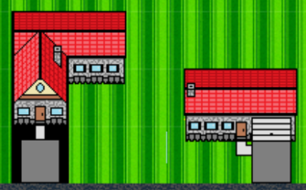


Updates to Art
Vince McKeown
Gonzalo Delgado

Slide 6
Updates to Sound
Alan Z
Updates to Background Music

Slide 7
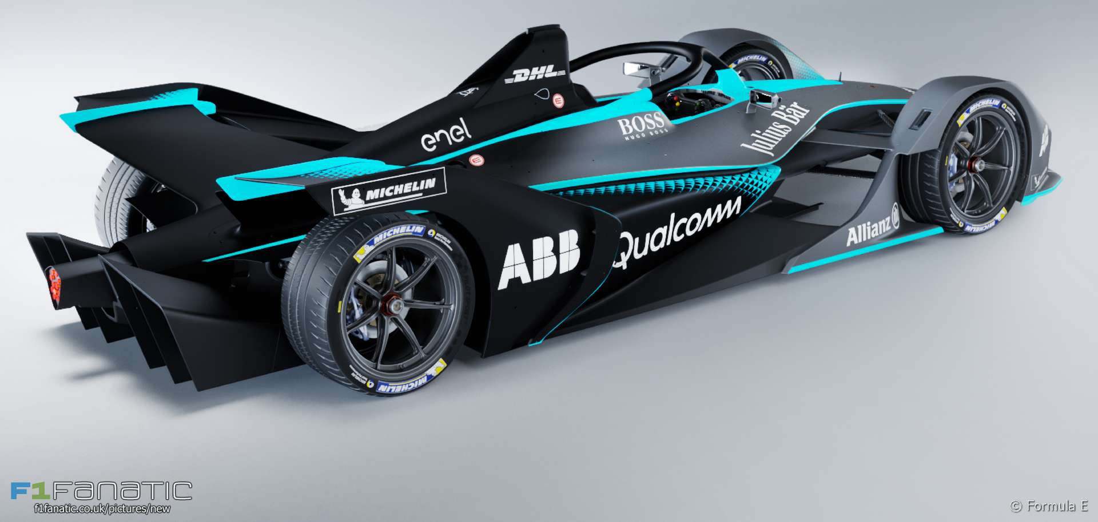
Demo
Cutover to Game

Slide 8
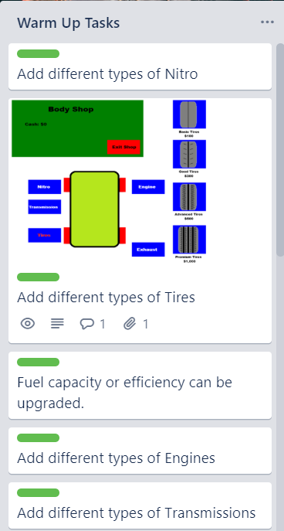
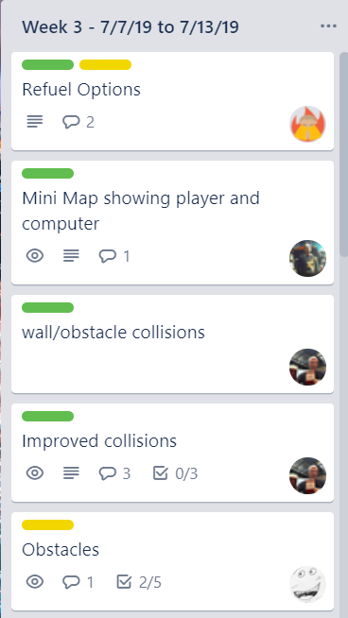
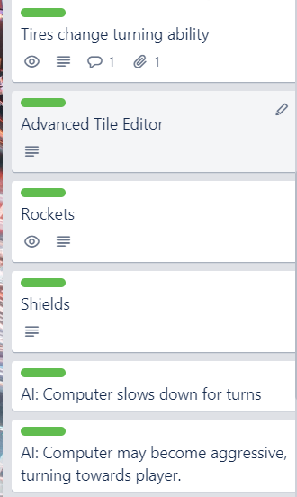
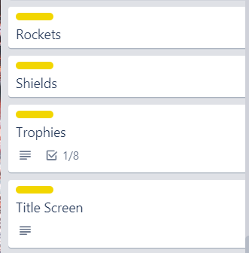
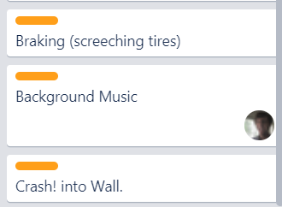
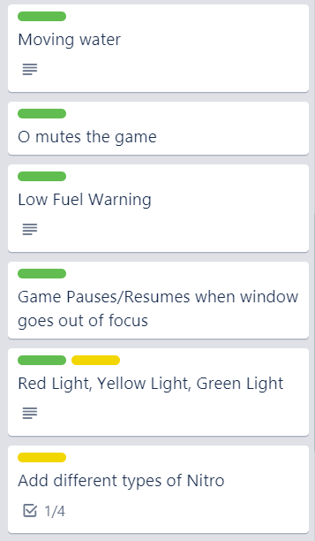
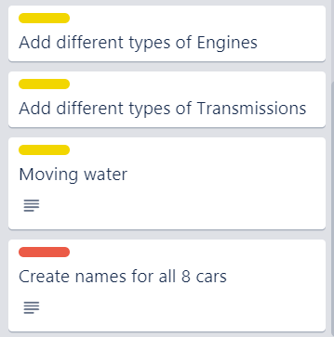
Week 3 Schedule
Committed
Code
Artwork
Sound

